Slide 1
Categorizing US Dialysis Facilities Based on Patients’ Health Data
Finding Patterns Using Unsupervised Learning Algorithms
Benhur Tedros

Slide 2
Annually, 650,000 people experience kidney failure in US , and its rate is increasing by 5% each year. Patients visit one of the several dialysis facilities in the country.

Slide 3
The Problem
The mortality rate from dialysis facility to another and State to State is different. Can a unique similar pattern in the dialysis centers be found based on the patient's’ health data and other related data?
The practice of dialysis facilities can be similar or different from each others. One can benefit from the other.

Slide 4
The Solution
Reduce the mortality rate in the dialysis facilities to its lowest level
Dialysis facility can make some improvement to their practices by following those facilities with the lowest mortality rate.

Slide 5
Methods
DATA WRANGLING
US dialysis facilities data from Centers for Medicare & Medicaid Services is wrangled and cleaned. Additional dataset on population size and household income of the counties are also added.
BUILD CLUSTERING MODEL
Split the dataset into training and testing dataset
Clustering models are fitted to the training dataset
MODEL EVALUATION & RESULT PATTERNS
Applying selected model to the testing dataset and evaluate model performance
Viewing the dialysis facilities in each cluster based on their State

Slide 6
MODELS UTILIZED
DBSCAN
Agglomerative Clustering
Views clusters as areas of high density separated by areas of low density
Build nested clusters by merging or splitting them successively
Affinity Propagation
K-Means
Separate dialysis facilities in N groups of equal variance by minimizing within-cluster sum of squares
Builds clusters by sending messages between pairs of samples until convergence

Slide 7
MODEL SELECTION
DBSCAN
Silhouette score: 32 %
Affinity Propagation
Silhouette score: 4.3 %
K-Means
Silhouette score:
71% with number of cluster of 4
Agglomerative Clustering
Silhouette score:
63 % with number of cluster of 4

Slide 8
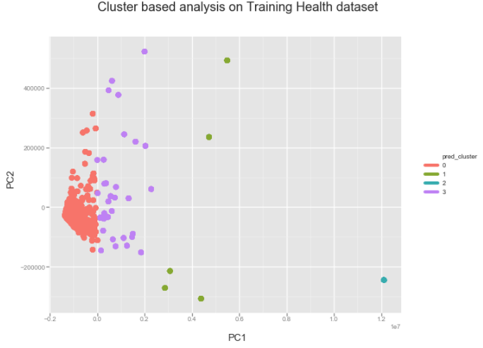
Results

Slide 9
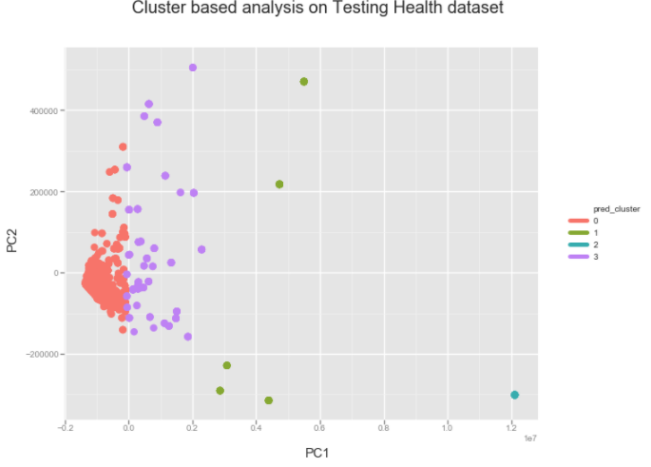
Cont’

Slide 10
Cont’
From the clustering analysis, 5248, 1007, 384 and 171 observations (dialysis facilities) were grouped into cluster-0, cluster-3, cluster-2 and cluster-1 respectively
 | Cluster_0 | Cluster_1 | Cluster_2 | Cluster_3
Number of Dialysis Facilities | 5248 | 171 | 384 | 1007

Slide 11
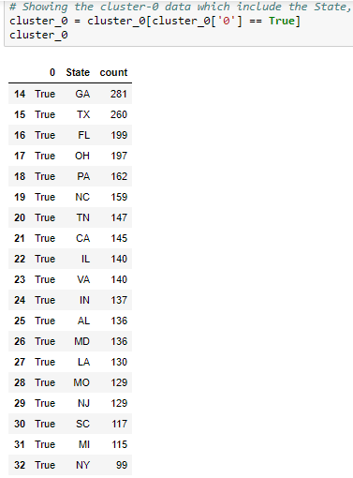
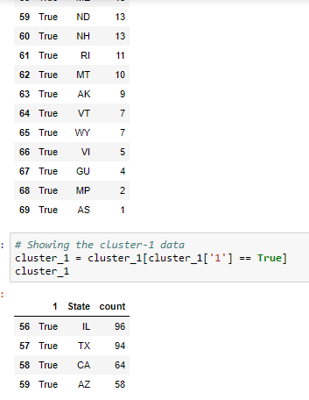
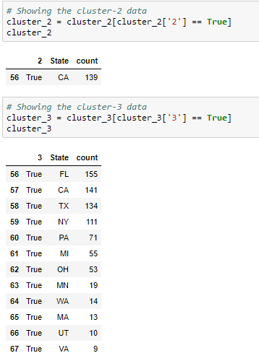
State based counts of the dialysis centers grouped into different clusters

Slide 12
Client Recommendations
Study the similarities of the dialysis facilities in one cluster
Continue further research on each cluster dataset separately
Learn the similarities and differences of dialysis centers within the same State, but clustered into different groups
1
2
3

